Slide 1
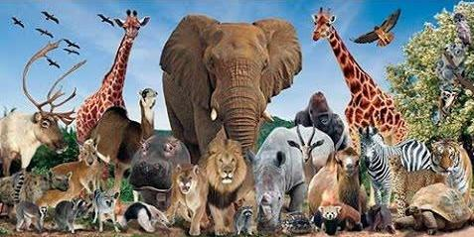
How to tell wild animalS
By CAROLYN WELLS

Slide 2
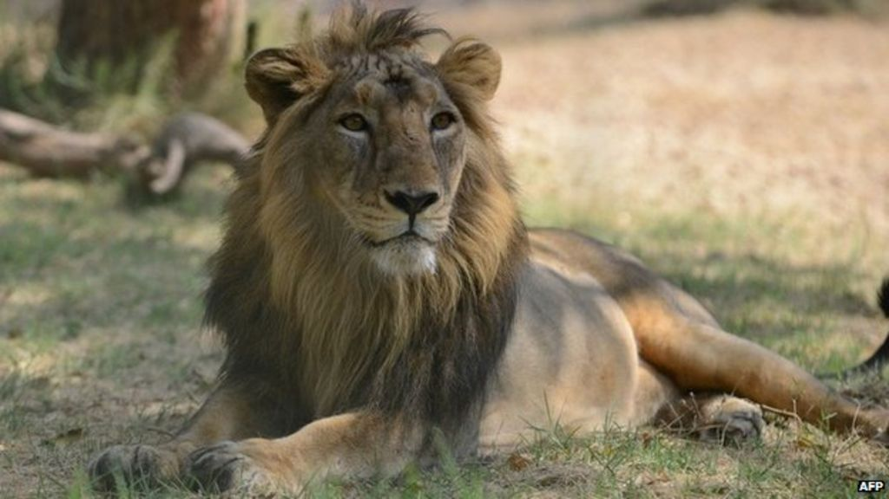
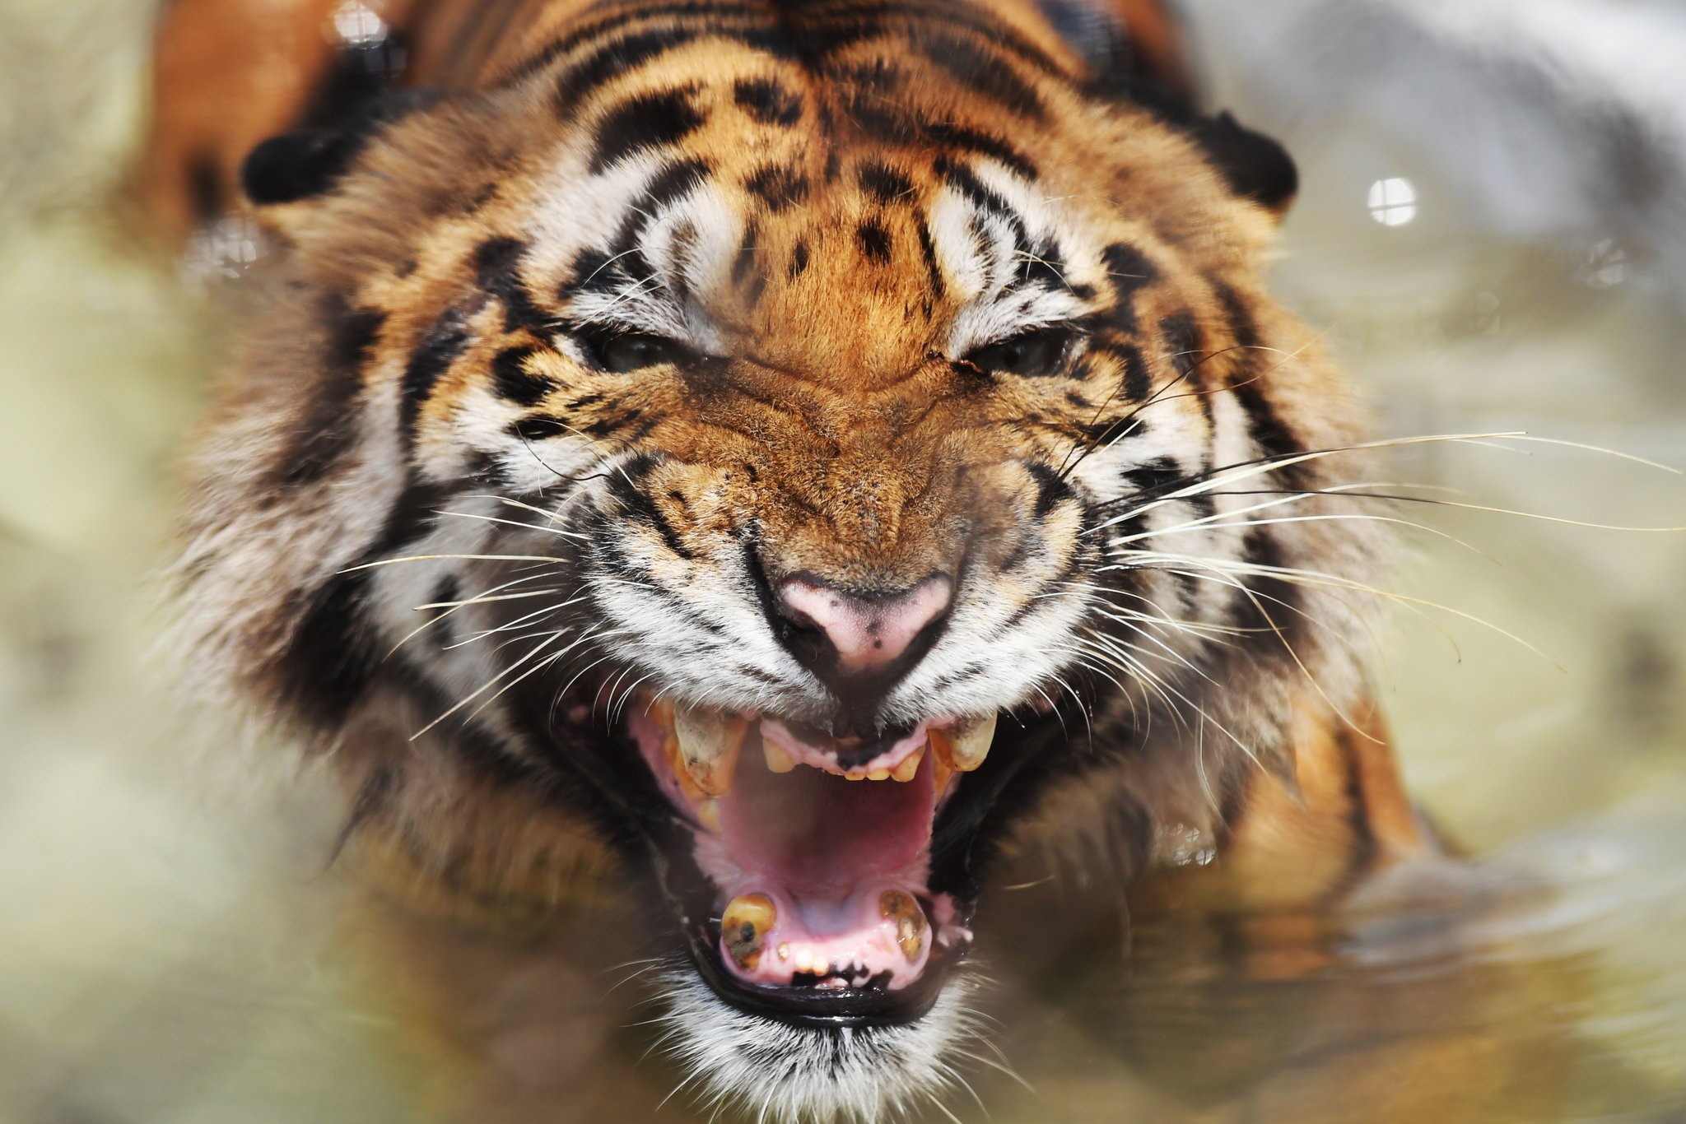
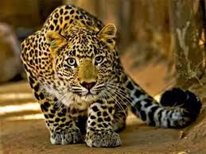
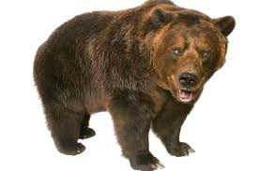
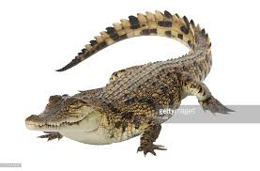
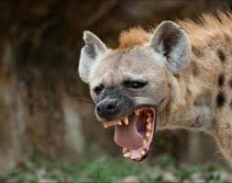
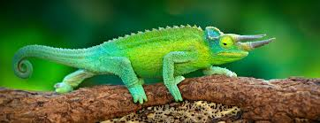

Slide 3
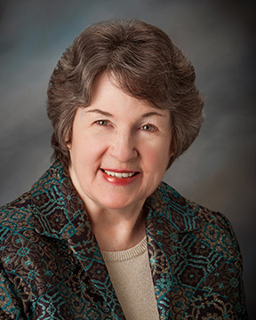
ABOUT THE POET
Carolyn Wells was born on June 18, 1862 in The United States. She was a prolific American writer remembered largely for her popular mysteries, children’s books and humorous verse. Her light- hearted poetry writing was aimed, primarily, at children. She wrote for almost 40 years. And she was a frequent contributor of Nonsense verse and whimsical pieces to such little magazines as The Lark, the Chap Book and the Philistine. Her books include A NONSENSE ANTHOLOGY, THE BOOK OF HUMOROUS VERSE, THE BOOK OF LIMERICKS, HORROR HOUSE, MURDER IN THE BOOKSHOP etc. This poem HOW TO TELL WILD ANIMALS is a humorous poem in which the poetess tells us how we may identify different wild animals.

Slide 4
INTRODUCTION
This humorous poem suggests some dangerous ways to identify wild animals. The poetess has also explained the characteristics of various wild animals in a very funny way. She has used language in a way that it generates humour. She introduces the reader to various kinds of wild animals like the Asian lion, the Bengal tiger, bear, etc. explaining each of the animals in a very humorous way. She describes the Hyena for its smiling face and the crocodile for its tears. Then the poetess describes how the chameleon changes its colour.

Slide 5
WORD MEANINGS
Tawny : brownish yellow
Dyin’ : dying
Discern : make out, identify
Strolling : wandering
Hide : animal skin
Peppered : covered with spots
Caress : a gentle, loving touch
Distinguish : identify
Novice : a beginner, someone new to a job
Nonplused : confused, surprised

Slide 6
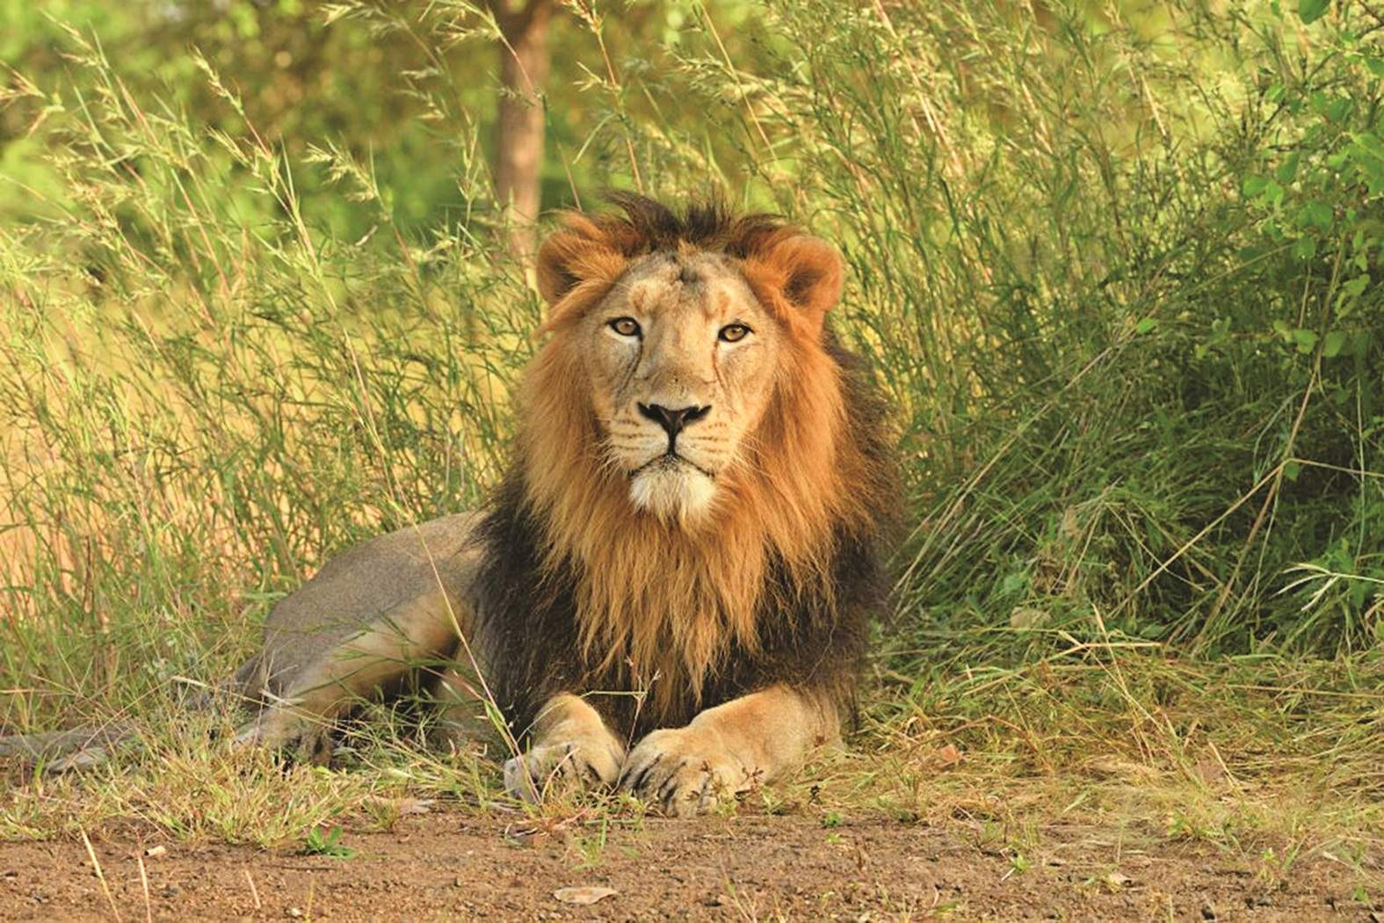
EXPLANATION STANZA 1
The poetess here cautions the readers against the wild beasts found in the jungle. She says if by chance you reach the jungles in the east, you are likely to encounter a large and tawny beast approaching you and if its roars loudly at you and you feel that you are going to die due to fear then you can be sure that it is the Asian lion.

Slide 7
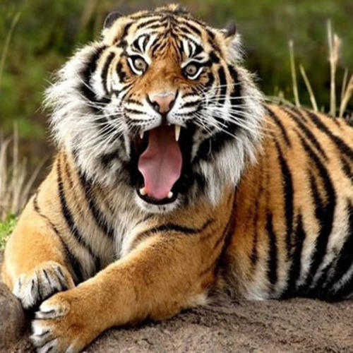
STANZA 2
In this stanza the poetess tells us how to identify a Bengal tiger. She says that if you are roaming around in the jungle and come across an animal with black and yellow stripes and the animal starts eating you, then this simple rule will teach you that it is a Bengal Tiger .

Slide 8
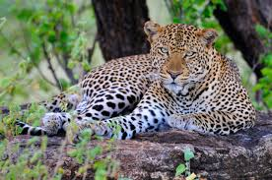
STANZA 3
Here the poet says that if you are casually walking in the forest and you come across an animal with black spots on its body it’s going to be a leopard. The animal is so fast that it will leap on you at once. There is no escape from him even if you cry out in pain because he will continue pouncing on you and start eating you before you understand that it is a leopard.

Slide 9
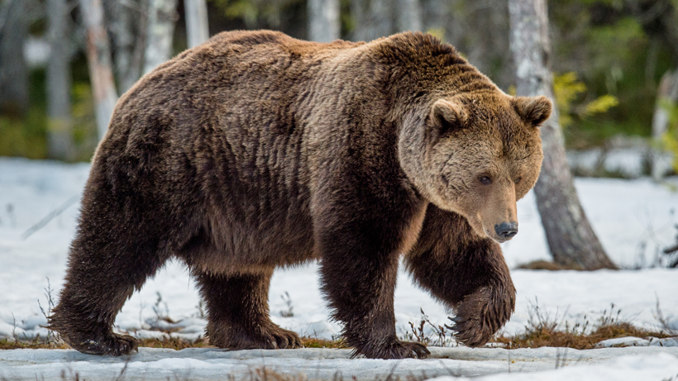
STANZA 4
In this stanza Carolyn Wells says that while you are walking around in your yard, you may meet a creature there. When this creature hugs you very tightly, then you can be sure that it is a bear. If you have any doubt in your mind then he will just give you another tight hug. This hug may seem friendly but it can be fatal.

Slide 10
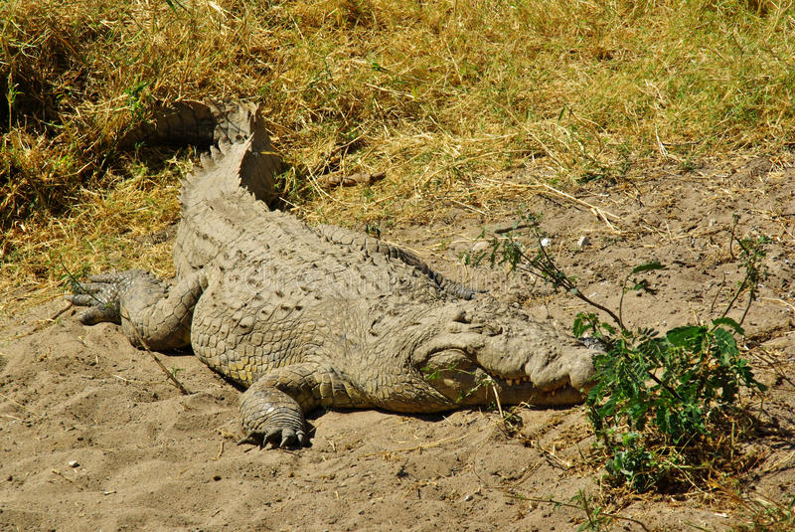
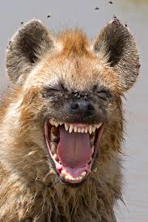
Stanza 5
The poetess says that sometimes it becomes quite difficult for a novice ( a beginner) to differentiate between the different wild animals. He may not be able to distinguish between a hyena and a crocodile. So, the poet helps to differentiate a crocodile from a hyena. She says that a hyena always laughs as it swallows its victim. A crocodile, on the other hand, is said to shed tears while eating its prey.

Slide 11
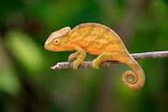
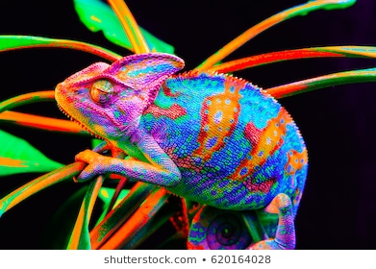
Stanza 6
In this stanza the poetess describes a chameleon. She says that a true chameleon is a small animal. It resembles a lizard. It doesn’t have ears or wings. The poetess says that if you are not able to see anything on the tree, then chances are there that that a chameleon is sitting there. The chameleon is a master of camaouflage as it changes colour as per its surroundings. Thus it is difficult to spot it. This attribute helps it to escape from its enemies.

Slide 12
EXERCISE FOR PRACTICE
1. What does the poet say about the Asian Lion in this poem?
2. How does the Bengal Tiger look? What is so distinct about him?
3. Why does the poet say that a bear’s hug may confuse a novice?
4. How does a crocodile behave when he sees someone?
5. What does the poet say about the crocodile and the hyena?

Slide 13
Module 1 end

